Slide 1
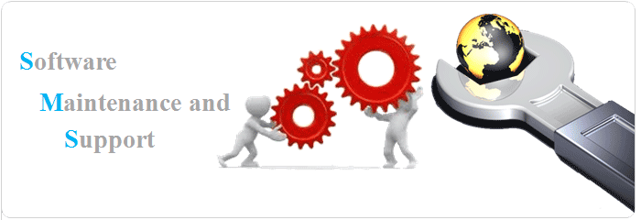
CSEN 6101
Module III : Software Maintenance
Software Engineering (SE) → CSEN 3202 – CSE/BTech/6th Semester → Module-IV → Prepared by : Nilina Bera, CSE, HITK

Slide 2
Why we need software maintenance ?
Software maintenance in software engineering is the modification of a software product after delivery to correct faults, to improve performance or other attributes.
A common perception of maintenance is that it merely involves fixing defects.
What is the purpose behind the software maintenance?
We need to upgrade our system with latest technologies
We need our software to work smooth while integrating to multiple other tools, frameworks, features, functionalities, etc.
We need to find out if our software has any execution errors
Also, to keep a regular check on whether there are any chances to upcoming errors
Nilina Bera

Slide 3
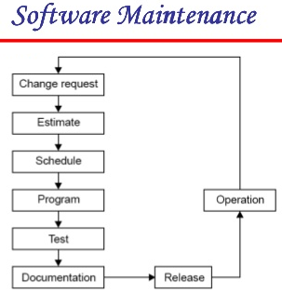
Nilina Bera

Slide 4
Necessity of software maintenance
Software maintenance is becoming an important activity of a large number of software organizations.
When the hardware platform is changed, and a software product performs some low-level functions, maintenance is necessary.
Also, whenever the support environment of a software product changes, the software product requires rework to cope up with the newer interface.
For instance, a software product may need to be maintained when the operating system changes.
Thus, every software product continues to evolve after its development through maintenance efforts.
Therefore it can be stated that software maintenance is needed to correct errors, enhance features, port the software to new platforms, etc.
Nilina Bera

Slide 5
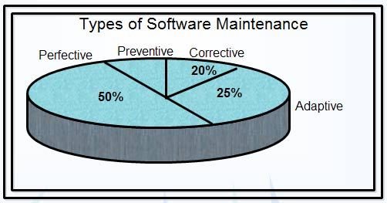
Types of software maintenance
5 %
Nilina Bera

Slide 6
Types of software maintenance
There are basically three types of software maintenance →
• Corrective: Corrective maintenance of a software product is necessary to rectify the bugs observed while the system is in use.
• Adaptive: A software product might need maintenance when the customers need the product to run on new platforms, on new operating systems, or when they need the product to interface with new hardware or software.
• Perfective: A software product needs maintenance to support the new features that users want it to support, to change different functionalities of the system according to customer demands, or to enhance the performance of the system.
iMPORTANT
Nilina Bera

Slide 7
Types of software maintenance
Preventive: Preventive maintenance involves performing activities to prevent the occurrence of errors.
It tends to reduce the software complexity thereby improving program understandability and increasing software maintainability. It comprises documentation updating, code optimization, and code restructuring.
Documentation updating involves modifying the documents affected by the changes in order to correspond to the present state of the system.
Code optimization involves modifying the programs for faster execution or efficient use of storage space.
Code restructuring involves transforming the program structure for reducing the complexity in source code and making it easier to understand.
Nilina Bera

Slide 8
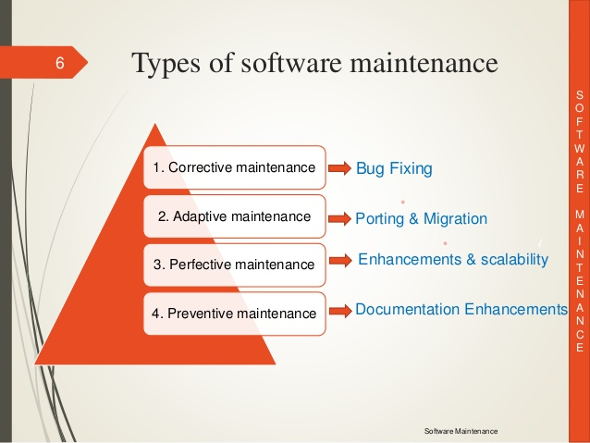
Nilina Bera

Slide 9
Problems associated with software maintenance
Software maintenance work typically is much more expensive than what it should be and takes more time than required.
In software organizations, maintenance work is mostly carried out using ad hoc techniques.
The primary reason being that software maintenance is one of the most neglected areas of software engineering.
Software maintenance has a very poor image in industry. Therefore, an organization often cannot employ bright engineers to carry out maintenance work.
Even though maintenance suffers from a poor image, the work involved is often more challenging than development work.
During maintenance it is necessary to thoroughly understand someone else’s work and then carry out the required modifications and extensions.
Another problem associated with maintenance work is that the majority of software products needing maintenance are legacy products.
Nilina Bera

Slide 10
Legacy systems
Because of the time and effort required to develop a complex system, large computer-based systems usually have a long lifetime. For example, military systems are often designed for a 20-year lifetime, and much of the world’s air traffic control still relies on software and operational processes that were originally developed in the 1960s and 1970s. It is sometimes too expensive and too risky to discard such business-critical systems after a few years of use. Their development continues throughout their life with changes to accommodate new requirements, new operating platforms and so forth.
Legacy systems are socio-technical computer-based systems that have been developed in the past, often using older or obsolete technology. These systems include not only hardware and software but also legacy processes and procedures—old ways of doing things that are difficult to change because they rely on legacy software. Changes to one part of the system inevitably involve changes to other components,
Legacy systems are often business-critical systems. They are maintained because it is too risky to replace them.
For example, for most banks the customer accounting system was one of their earliest systems. Organizational policies and procedures may rely on this system. If the bank were to scrap and replace the customer accounting software (which may run on expensive mainframe hardware) then there would be a serious business risk if the replacement system didn’t work properly. Furthermore, existing procedures would have to change, and this may upset the people in the organization and cause difficulties with the bank’s auditors.
Nilina Bera

Slide 11
Software reverse engineering
Software reverse engineering is the process of recovering the design and the requirements specification of a product from an analysis of its code.
The purpose of reverse engineering is to facilitate maintenance work by improving the understandability of a system and to produce the necessary documents for a legacy system.
Reverse engineering is becoming important, since legacy software products lack proper documentation, and are highly unstructured.
Even well-designed products become legacy software as their structure degrades through a series of maintenance efforts.
The first stage of reverse engineering usually focuses on carrying out cosmetic changes to the code to improve its readability, structure, and understandability, without changing of its functionalities.
A process model for reverse engineering has been shown in fig.1 below:
Nilina Bera

Slide 12
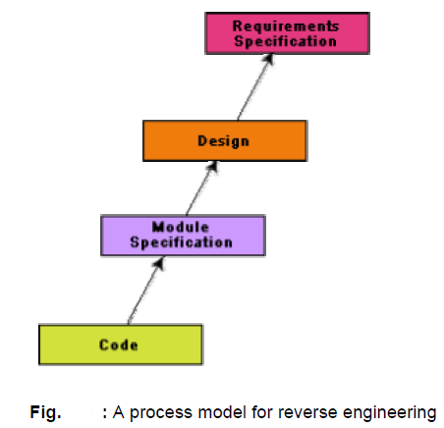
1
Nilina Bera

Slide 13
Software reverse engineering
After the cosmetic changes have been carried out on a legacy software, the process of extracting the code, design, and the requirements specification can begin.
These activities are schematically shown in fig. 2.
In order to extract the design, a full understanding of the code is needed.
Some automatic tools can be used to derive the data flow and control flow diagram from the code.
The structure chart (module invocation sequence and data interchange among modules) should also be extracted.
The SRS document can be written once the full code has been thoroughly understood and the design extracted.
Nilina Bera

Slide 14
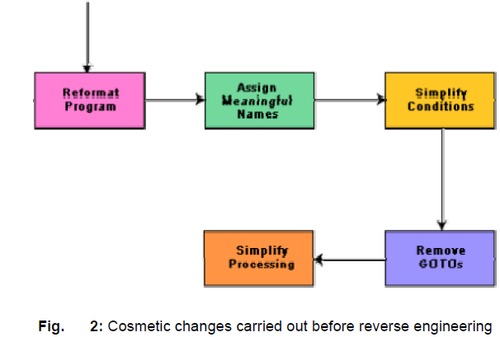
Nilina Bera

Slide 15
Factors on which software maintenance activities depend
The activities involved in a software maintenance project are not unique and depend on several factors such as:
the extent of modification to the product required
the resources available to the maintenance team
the conditions of the existing product (e.g., how structured it is, how well documented it is, etc.)
the expected project risks, etc.
When the changes needed to a software product are minor and straightforward, the code can be directly modified and the changes appropriately reflected in all the documents.
Nilina Bera

Slide 16
Software maintenance process models
Two broad categories of process models for software maintenance can be proposed. The first model is preferred for projects involving small reworks where the code is changed directly and the changes are reflected in the relevant documents later. This maintenance process is graphically presented in fig. 3. In this approach, the project starts by gathering the requirements for changes. The requirements are next analyzed to formulate the strategies to be adopted for code change.
The availability of a working old system to the maintenance engineers at the maintenance site greatly facilitates the task of the maintenance team as they get a good insight into the working of the old system and also can compare the working of their modified system with the old system. Also, debugging of the reengineered system becomes easier as the program traces of both the systems can be compared to localize the bugs.
Nilina Bera

Slide 17
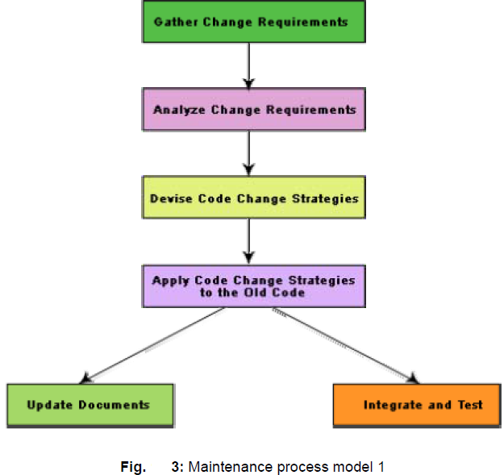
Nilina Bera

Slide 18
Software maintenance process models
The second process model for software maintenance is preferred for projects where the amount of rework required is significant. This approach can be represented by a reverse engineering cycle followed by a forward engineering cycle.
Such an approach is also known as software reengineering. This process model is depicted in fig. 4.
The reverse engineering cycle is required for legacy products. During the reverse engineering, the old code is analyzed (abstracted) to extract the module specifications.
The module specifications are then analyzed to produce the design.
Nilina Bera

Slide 19
Software maintenance process models
The design is analyzed (abstracted) to produce the original requirements specification.
The change requests are then applied to this requirements specification to arrive at the new requirements specification.
At the design, module specification, and coding a substantial reuse is made from the reverse engineered products.
An important advantage of this approach is that it produces a more structured design compared to what the original product had, produces good documentation, and very often results in increased efficiency.
The efficiency improvements are brought about by a more efficient design.
Nilina Bera

Slide 20
Software maintenance process models
However, this approach is more costly than the first approach.
An empirical study indicates that process 1 is preferable when the amount of rework is no more than 15% (as shown in fig. 5). Besides the amount of rework, several other factors might affect the decision regarding using process model 1 over process model 2:
Reengineering might be preferable for products which exhibit a high failure rate.
Reengineering might also be preferable for legacy products having poor design and code structure.
Nilina Bera

Slide 21
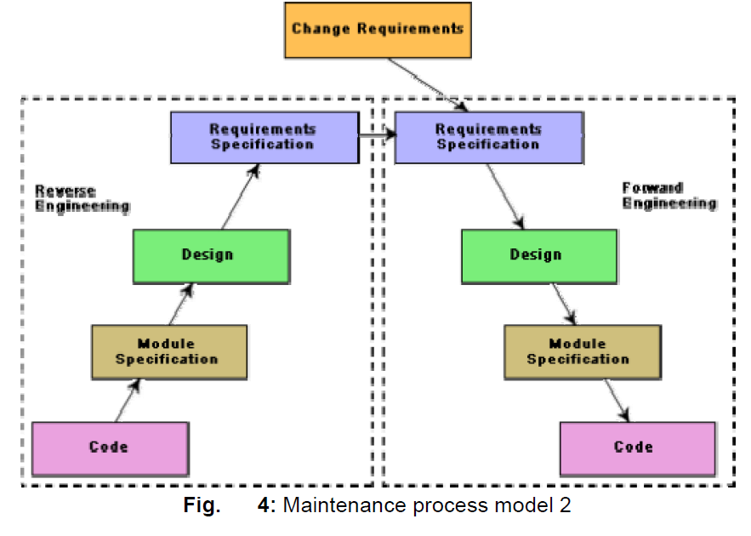
Nilina Bera

Slide 22
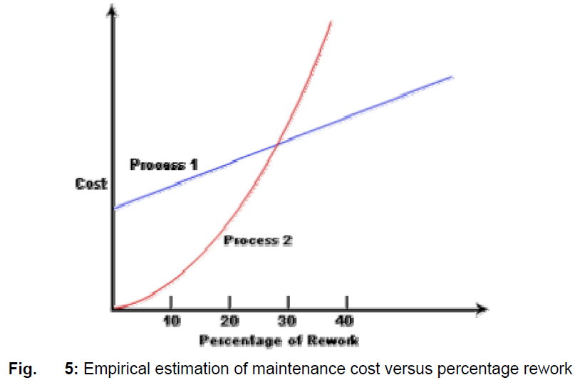
Nilina Bera

Slide 23
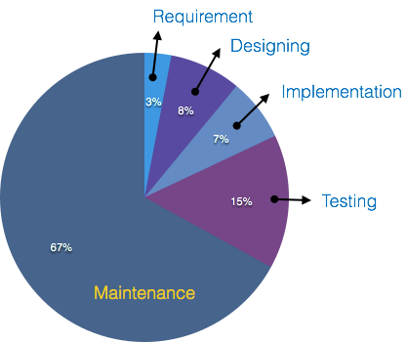
Maintenance cost is the highest among all the phases of software lifecycle.
Nilina Bera

Slide 24
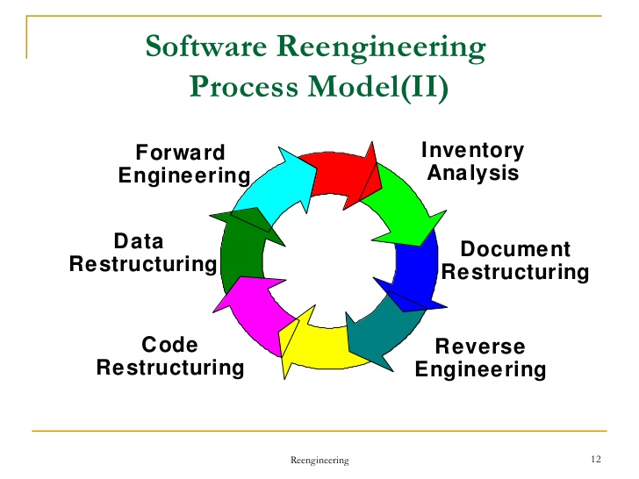
Software reengineering
Software reengineering is a combination of two consecutive processes i.e. software reverse engineering and software forward engineering as shown in the fig. 4.
Nilina Bera

Slide 25
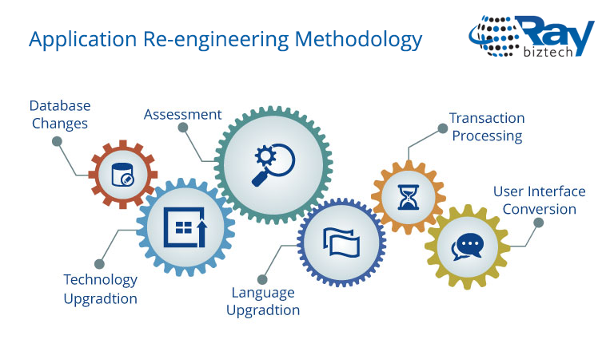
Nilina Bera

Slide 26
Software Maintenance Tools
Name | Description
File comparator | Compares two files or systems and maintains the record of the differences in the files. In addition, it determines whether the two files or the systems are identical.
Compiler and linker | Compilers are used to check syntax errors and in some cases, locate the type of errors. When the code is compiled, the linker is used to link the code with other components, which are required for the program execution. Linkers sometimes are used to track the version numbers of the components so that appropriate versions are linked together.
Debugger | Allows tracing the logic of the program and examines the contents of the registers and memory areas.
Cross-reference generator | Assures that the changes in code are in compliance with the existing code. When a change to a requirement is requested, this tool enables to know which other requirements, design, and code components will be affected.
Static code analyzer | Measures information about the code attributes such as the number of lines of code, number of spanning paths, and so on. This can be calculated when the new versions of the system are developed.
Nilina Bera

Slide 27
Fill In the blanks:
1. Software maintenance is the process of modifying the software system, …………., and ………………….. The performance and attributes of the software.
Ans: Correcting errors, improving
2. …………. maintenance is concerned with fixing errors that are observed when the software is in use.
Ans: Corrective
3. …………. phase of software maintenance life cycle focuses on feasibility study and refinement of modification request.
Ans: Problem analysis
4. The commonly used models for software maintenance are ……….. , ………………, and reuse-oriented model.
Ans: Quick-fix model, iterative enhancement model
5. ……….. helps in maintaining awareness of new software-related technologies and assists the organization in selecting the most suitable technology to improve software quality.
Nilina Bera
Ans: Technology change management

Slide 28
Multiple choice questions:
Which of the following purposes does software maintenance solve?
Improving the software to support user requirements.
Facilitating future maintenance work
Both (a) and (b)
None of the above
Ans: ©
2. Which of the following is not a technique used in software maintenence?
Re-engineering.
Reverse engineering
Technology change management
Software configuration management
Ans: ©
Nilina Bera

Slide 29
Multiple choice questions:
3. Which of the following functions do cross-reference generators perform?
Assure that the changes in code are in compliance with the existing code
Provide information about structure of software code
Make changes in software code documentation.
All of the above
Ans: A)
4. Which of the following creates a problem for the software maintenance team in software maintenance?
Cost of testing.
Software maintainability
Quality of documentation
Staff turnover
Ans: D)
Nilina Bera

Slide 30
State whether True or False:
1. Both software maintenance and maintainability are the same.
Ans: False
Maintainability is defined as the probability of performing a successful repair action within a given time. In other words, maintainability measures the ease and speed with which a system can be restored to operational status after a failure occurs.
Software maintenance in software engineering is the modification of a software product after delivery to correct faults, to improve performance or other attributes.
2. Impact analysis is concerned with the identification of objects and system components that are affected by modifications in the software system.
Ans: True
Nilina Bera

